Slide 1
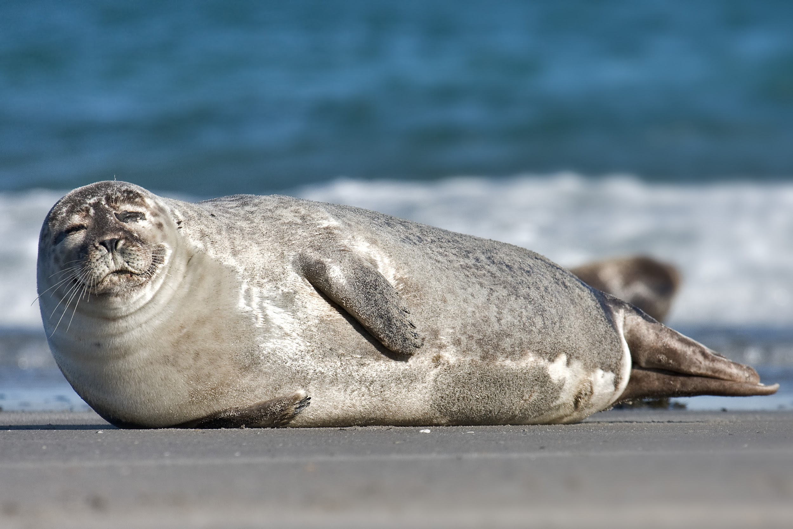
Harbor Seal Behavior
aka we stalked seals (Phoca vitulina, to be precise)
img url http://upload.wikimedia.org/wikipedia/commons/0/00/Common_Seal_Phoca_vitulina.jpg

Slide 2
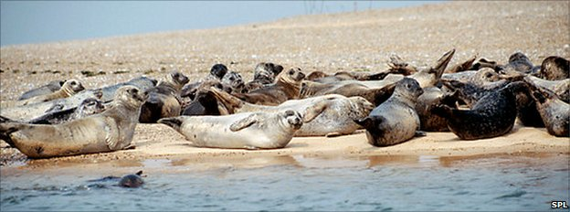

What is “Hauling Out”
Hauling out is a distinct behavior observed in members of the pinniped family (seals, sea lions etc.)
Pinnipeds will periodically leave the water and spend time on land, lying on sand or ice

Slide 3
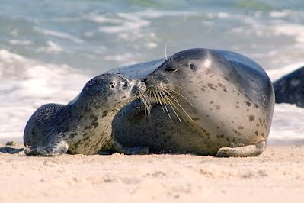
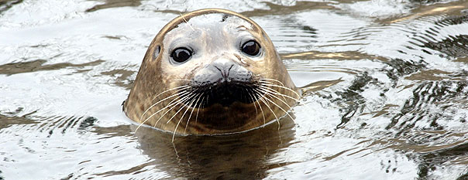
A Little Background:
Many pinnipeds haul out in cycles throughout the year in order to court and mate, give birth and nurture their young. Harbor seals are unique in that they haul out year round
Possible factors affecting haul-out behavior include: tides, air/water temperature, predator activity, fish availability, human interference
There is a local population of harbor seals in Morro Bay, the haul-out behavior of which is of particular interest to us

Slide 4
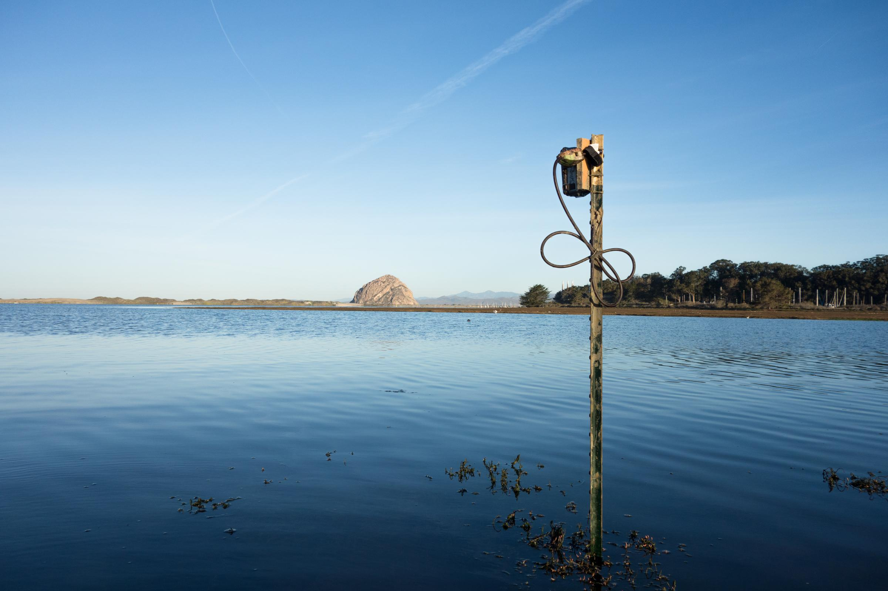
Our Project
We chose to look at the relationship between hauling out and:
Tides
Time of Day

Slide 5
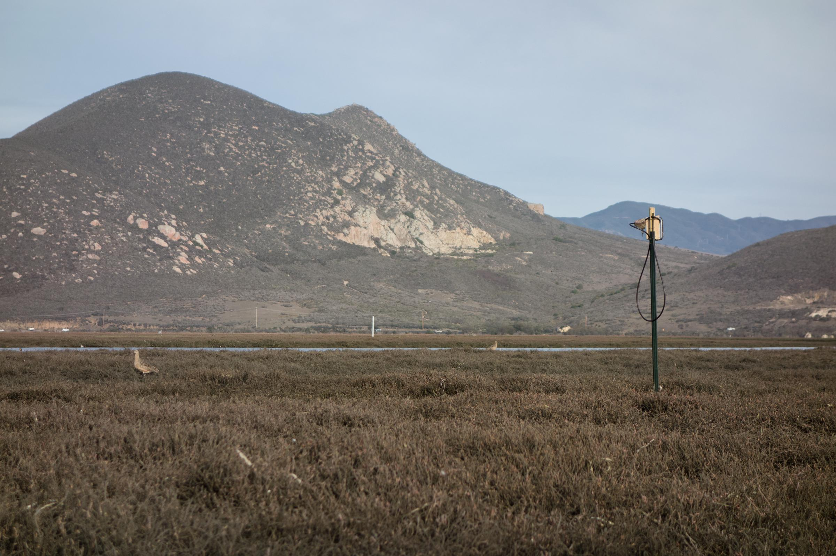
Hypothesis
As tidal levels rise food is more readily available, thus we hypothesize that less seals will be found at their typical haul-out area at high tide.
We also expect that haul out behavior is independent of time of day

Slide 6
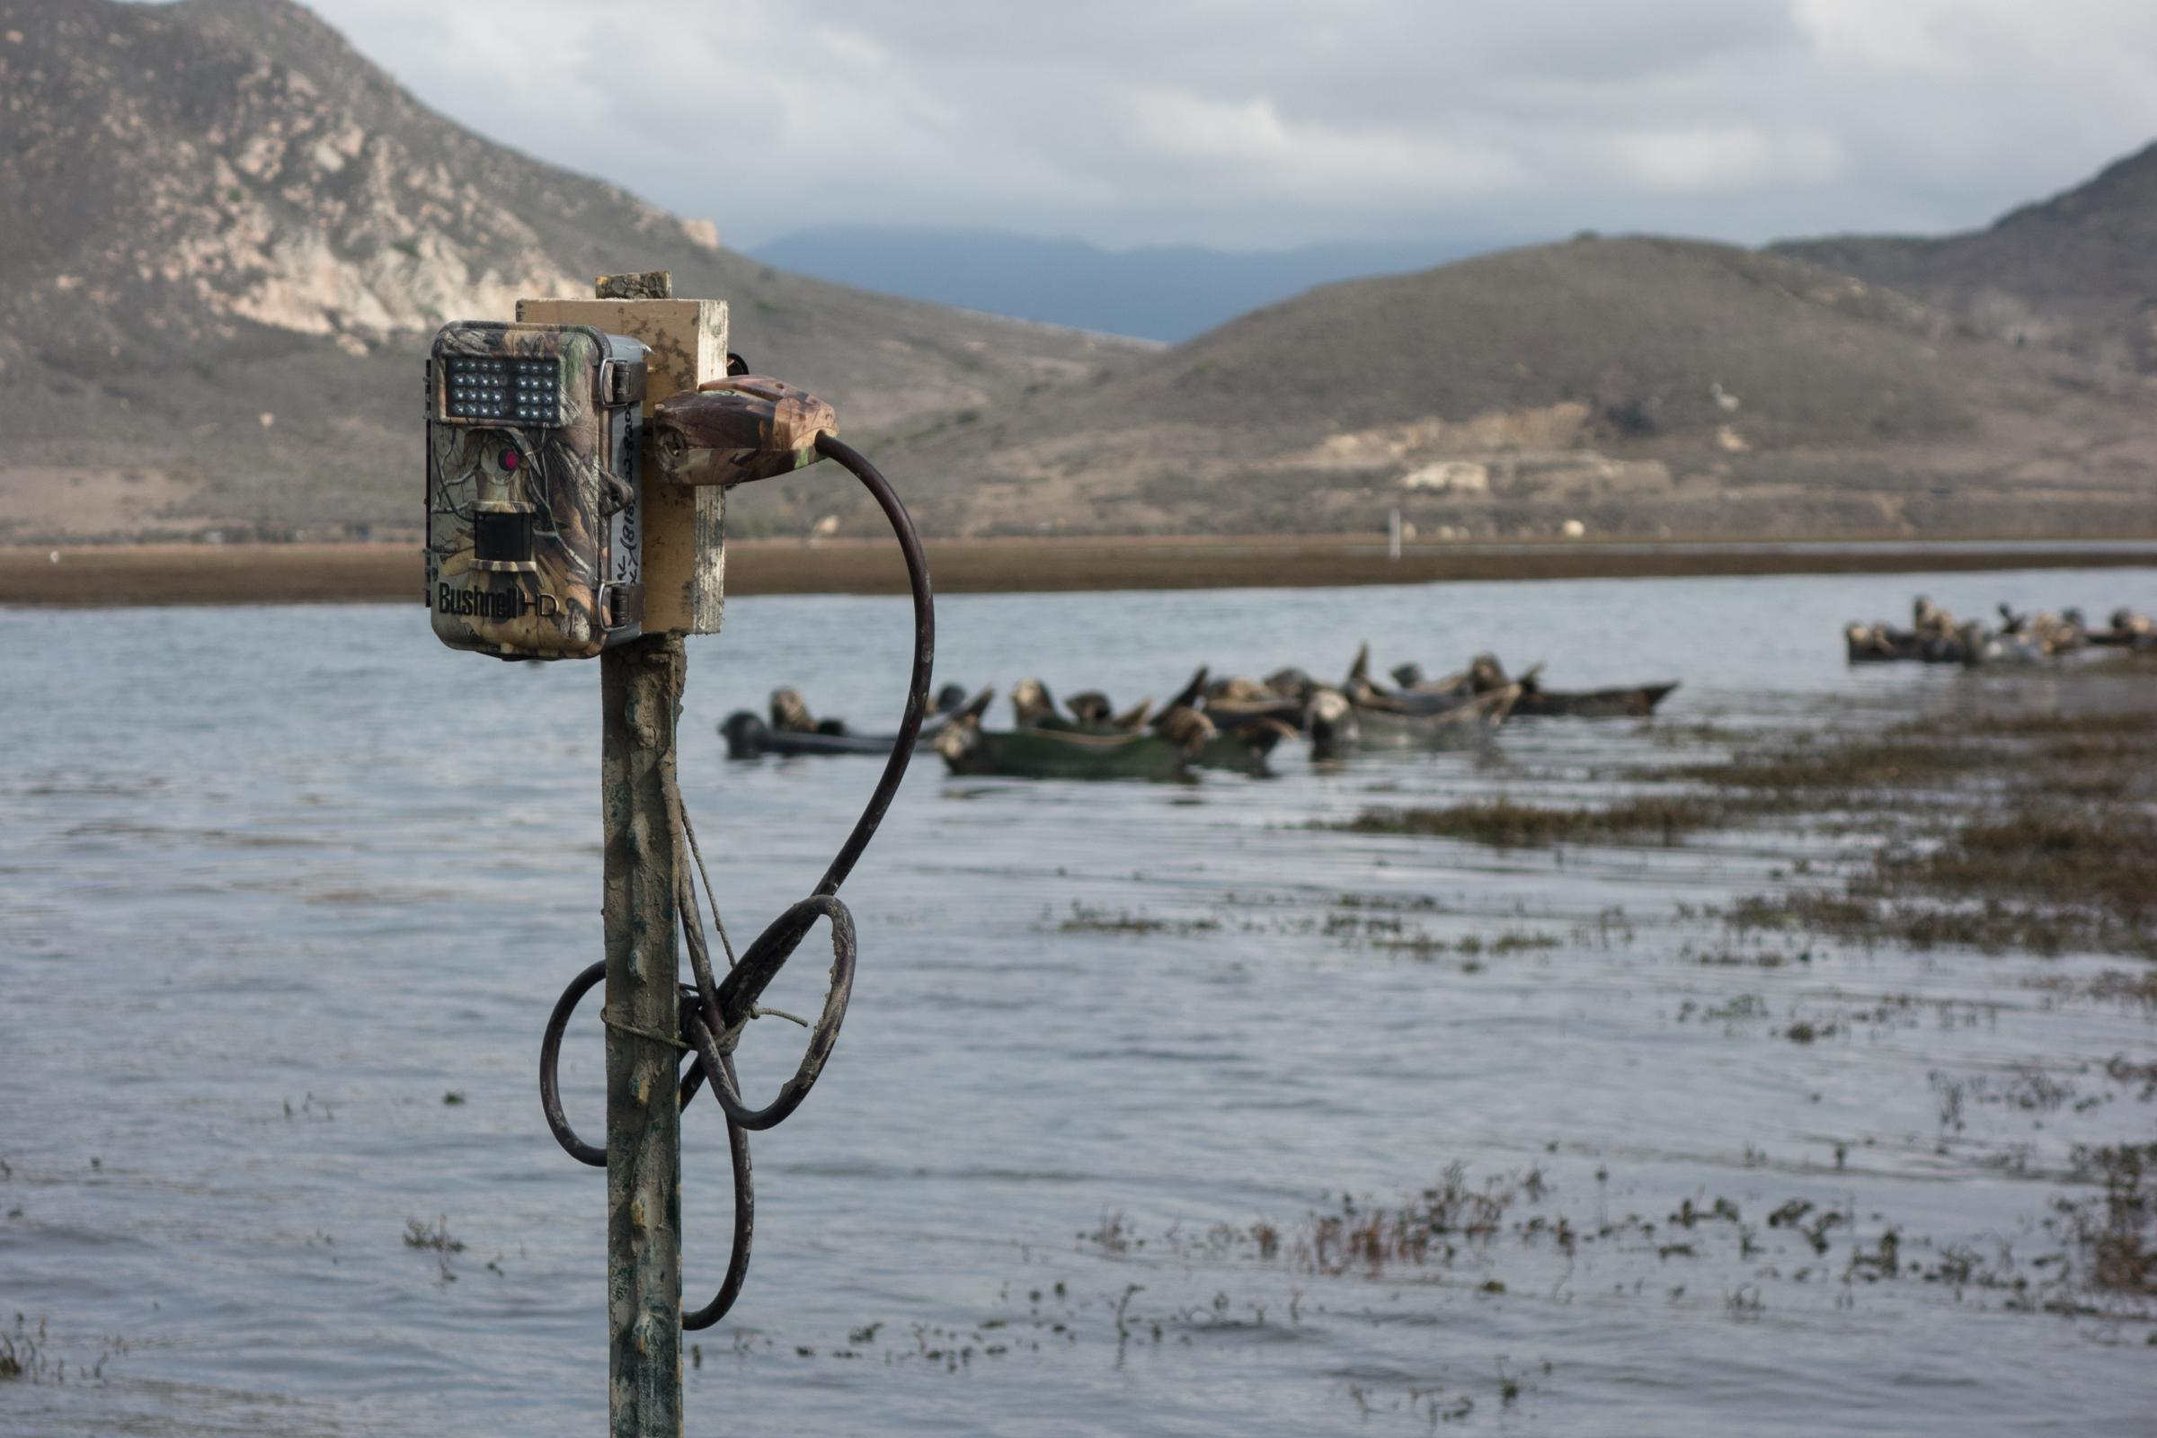
The Method behind the Madness
Trail cameras were used to observe site without our presence
photo taken every 15 minutes during daylight hours
Allowed us to count harbor seals more efficiently

Slide 7
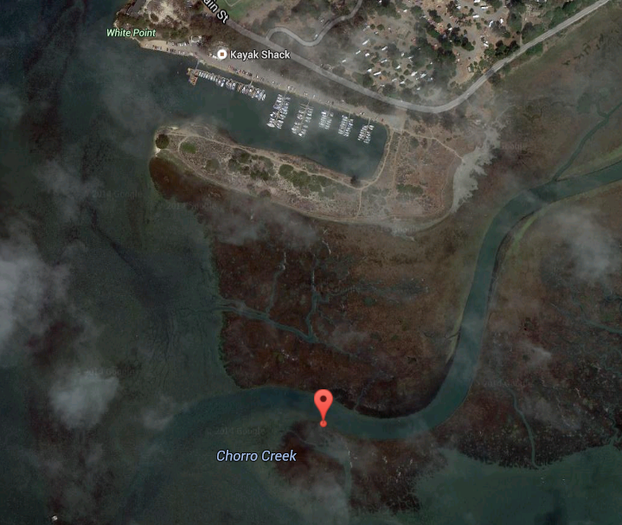
Site Selection
Morro Bay Estuary- Why it’s Ideal
Known to have two dependable haul out sites
Two haul out sites in the same area keep the data consistent

Slide 8
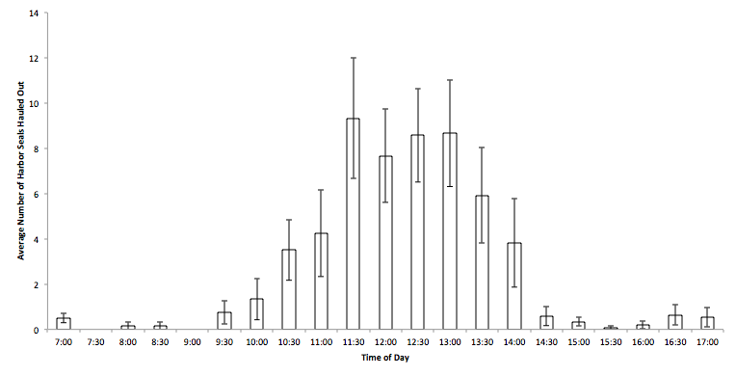
Results

Slide 9
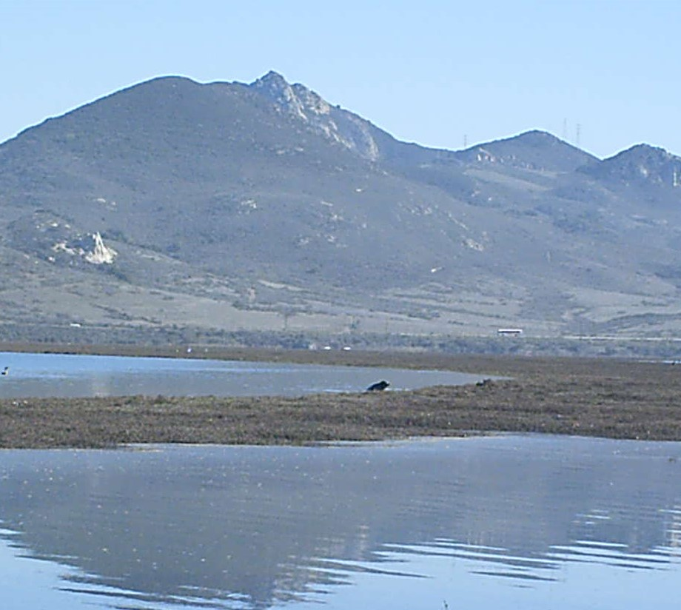
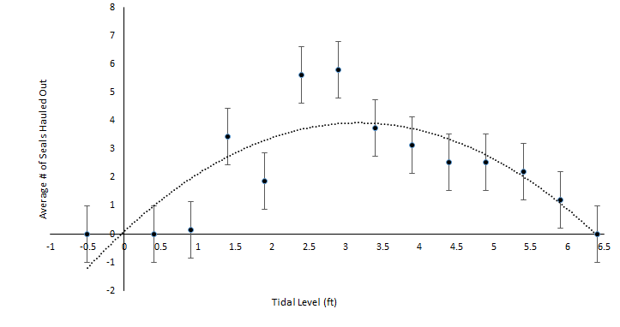
results cont.

Slide 10
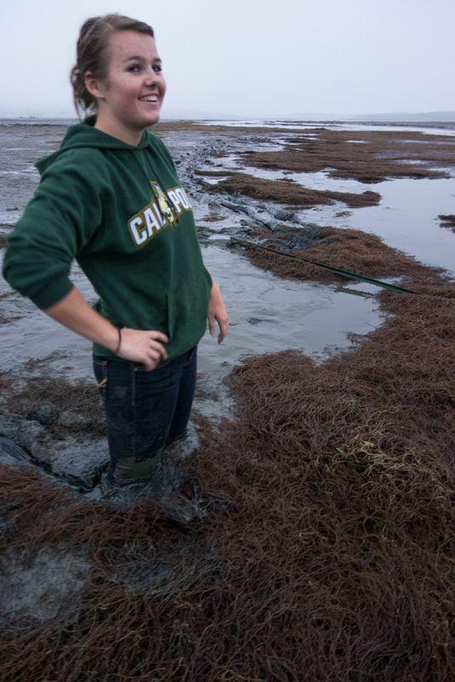
Discussion
Hypothesis: Not supported
Significantly more harbor seals were hauled out at high tide than
at low tide.
In the twelve days of data collected, there was never a seal caught
hauled out at a tide below 0.7’’
The most influential factor was shown to be time of day; harbor
seals were most likely to be hauled out in the middle of the day
Thoughts about why:
Low tide=more concentrated prey
Limited access to typical haul-out spots

Slide 11
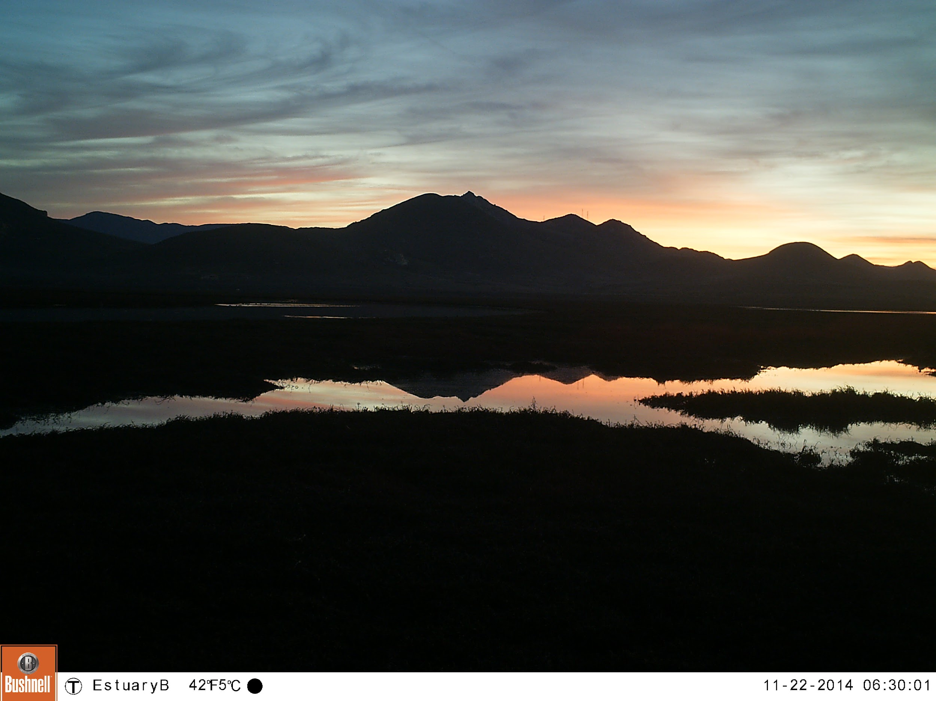
Reflection
Long term monitoring, afternoon low tide observations to rule out influence of tide
Follow up experiments:
human proximity
water/air temperature comparison

Slide 12
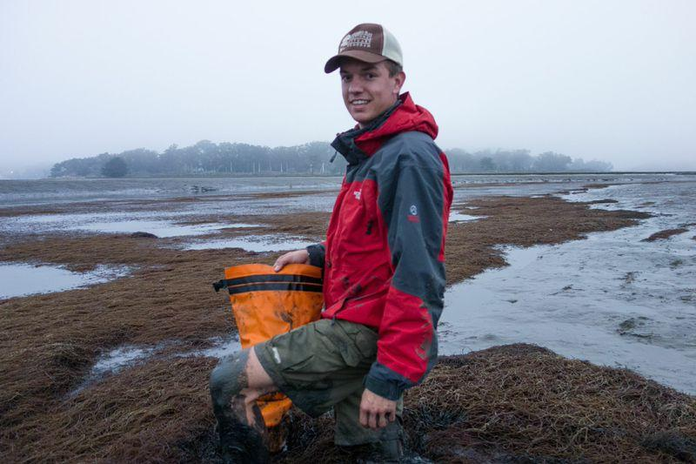
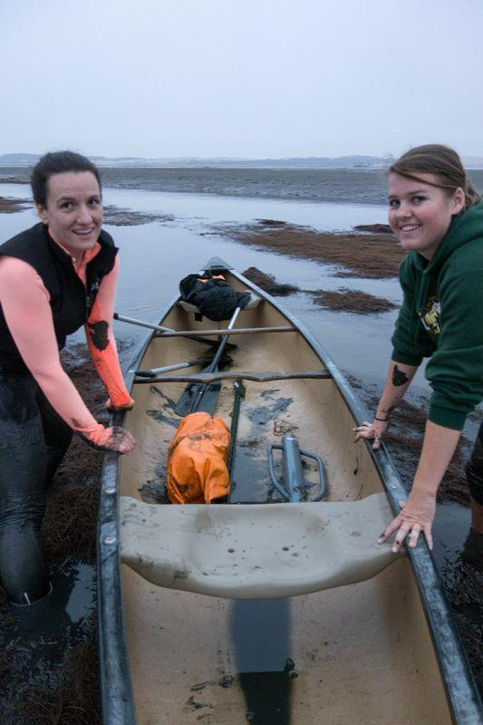
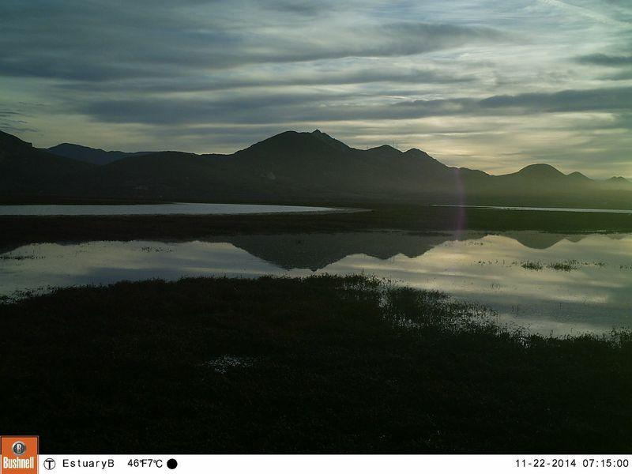

Slide 13
